Slide 1

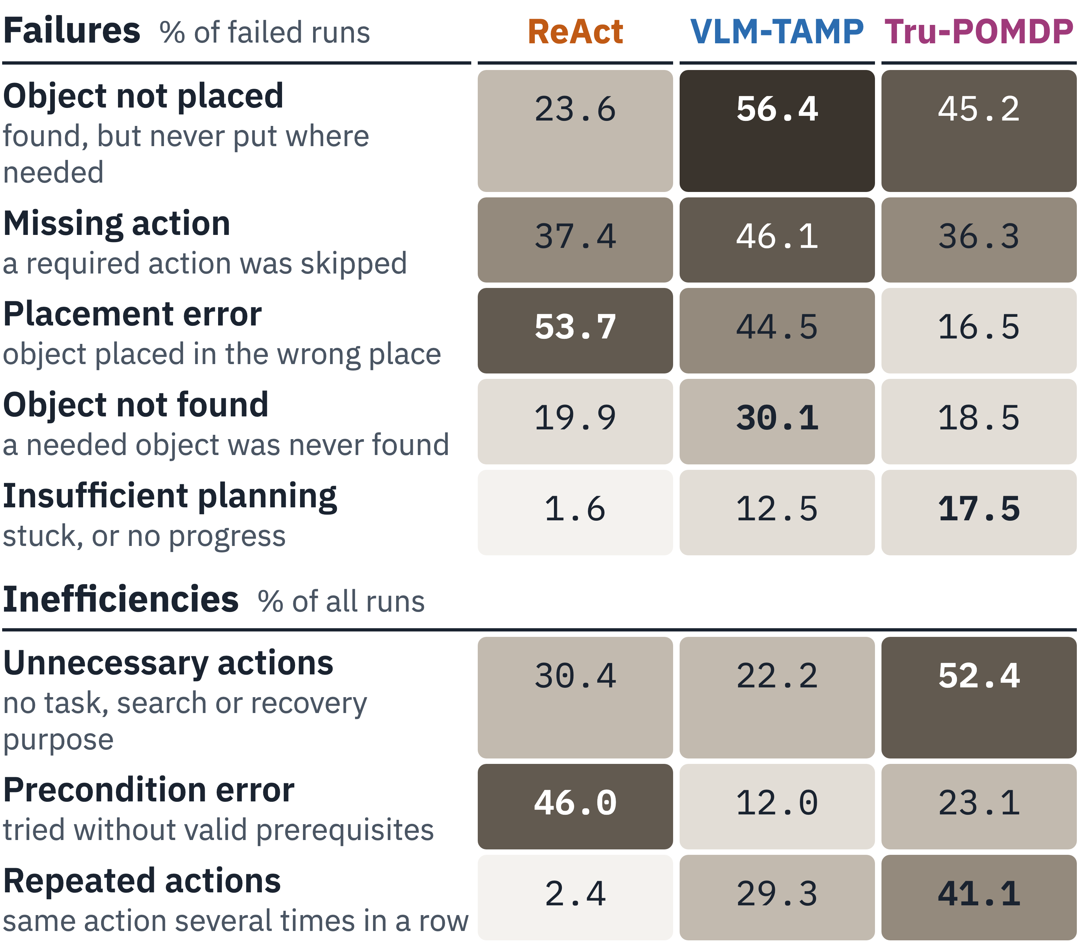
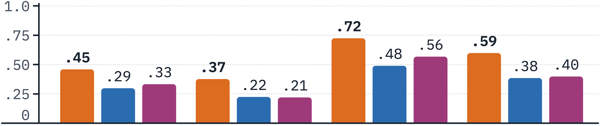
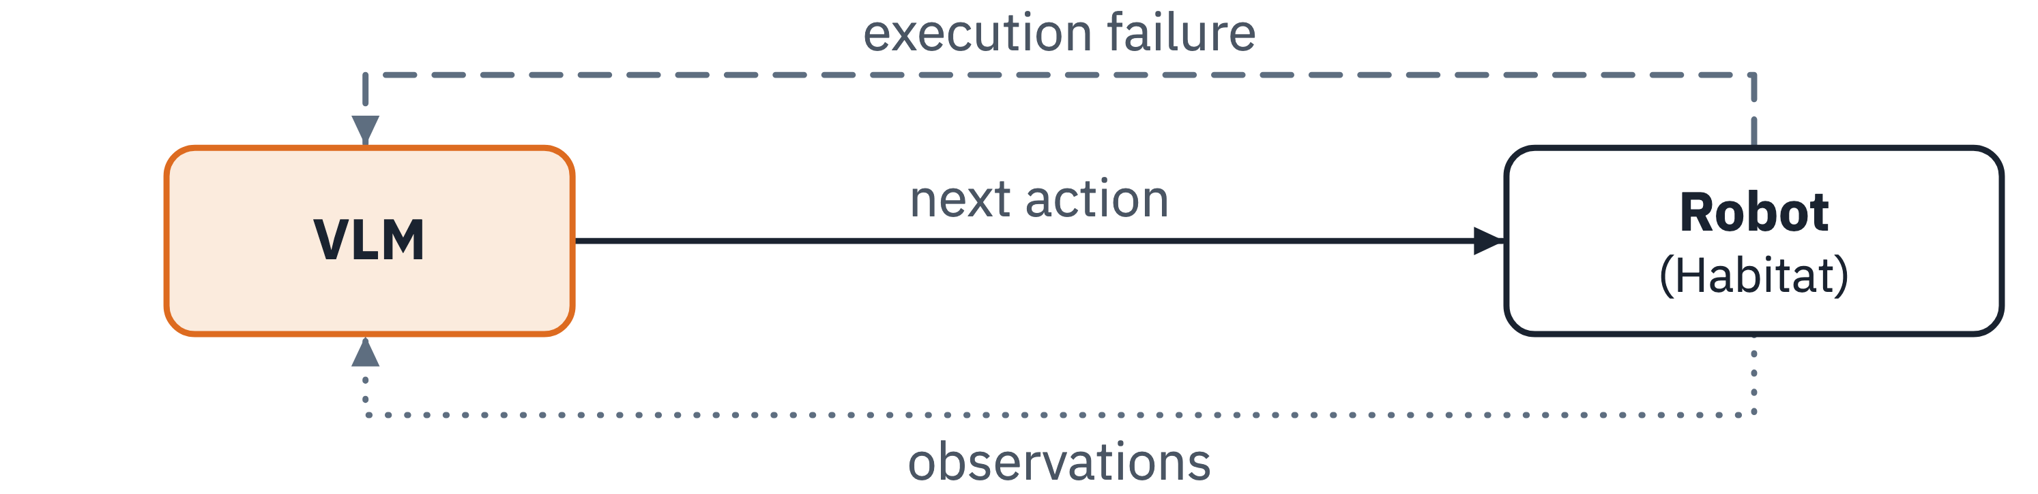
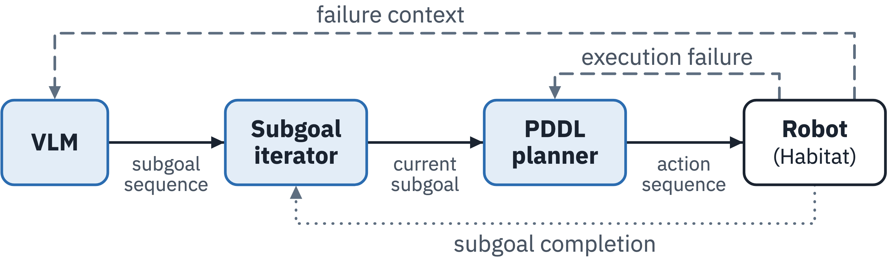
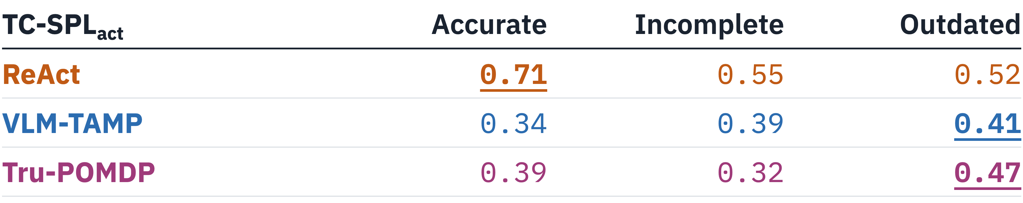
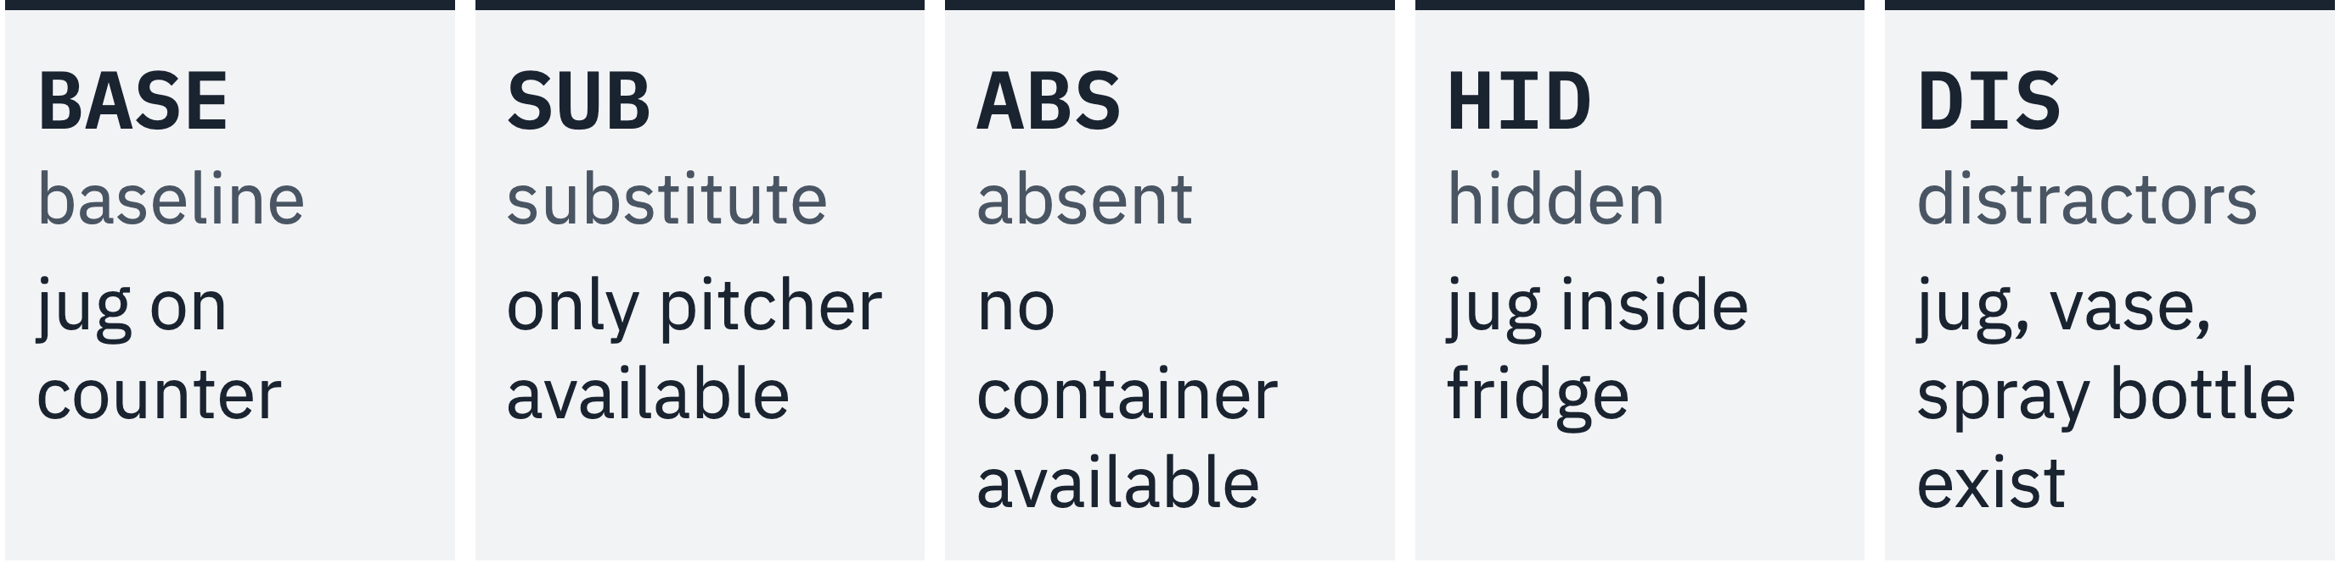
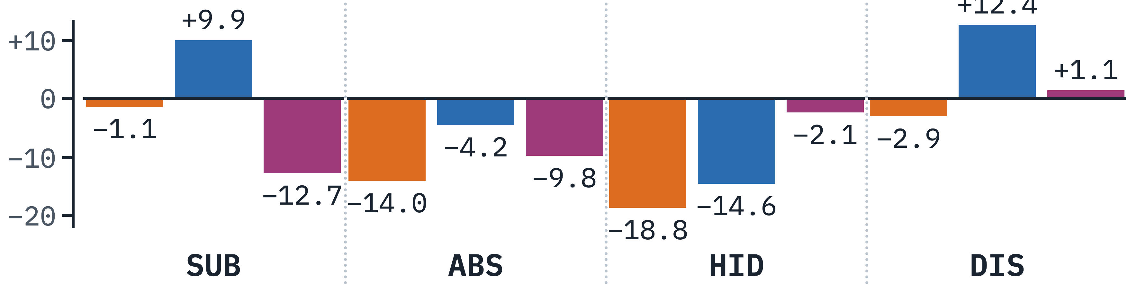
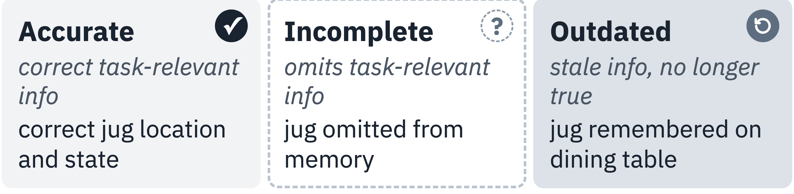
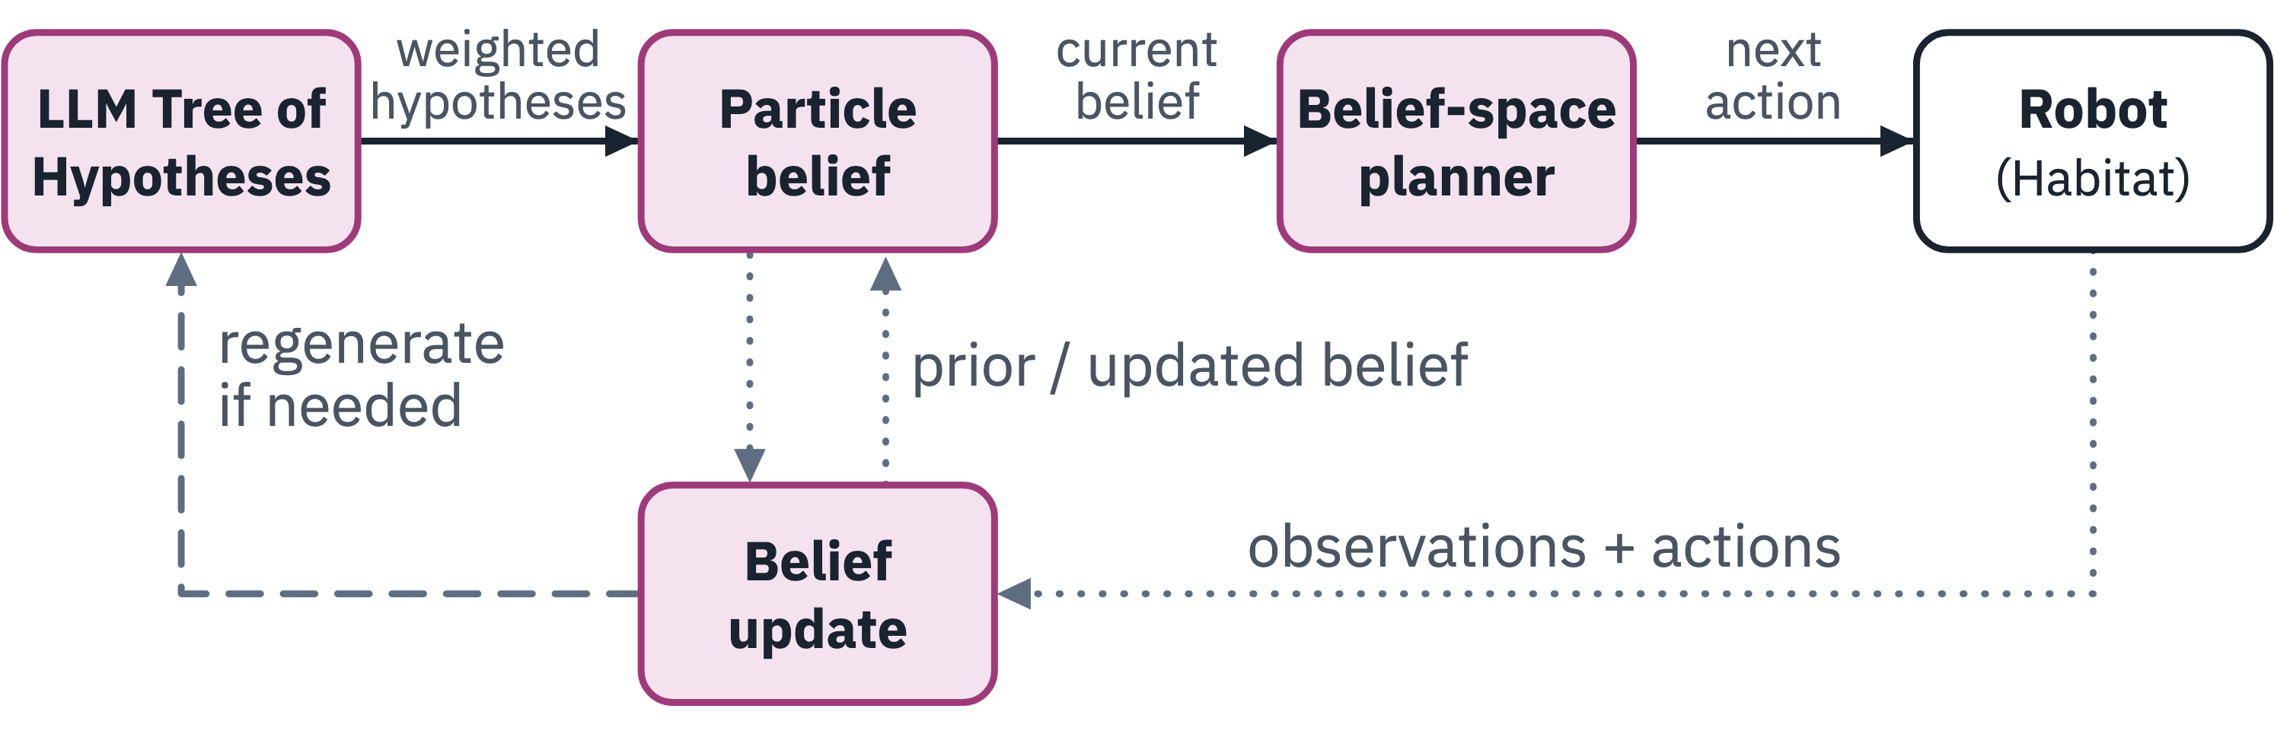
CoRL 2026 · LEAP Workshop
Evaluating Long-Horizon Robot Planning under Uncertainty
Harsh Muriki*, Gayathri Aravindan, Yuchen Zheng, Sonia Chernova
Georgia Institute of Technology · *vmuriki3@gatech.edu
01 The problem
03 Three planners, one framework
04 ReAct leads, but all incur extra actions
07 Failures and inefficiencies
In real homes, robots rarely hold accurate beliefs about their surroundings. An object remembered on a countertop may have been moved into a cabinet, replaced with a similar item, or removed entirely. Each case demands a different response: search, substitute, replan, or recognize the goal is infeasible.
Shared inputs: memory M · goal G · scene graph · images (not Tru-POMDP) · the same 12 high-level robot skills.
How we score
Rule-based labels on execution traces. Failures: why unsuccessful runs failed. Inefficiencies: wasted actions in any run. Labels overlap.
TC-SPL_{act}: fraction of the task completed, discounted by extra skill attempts vs. a human demo (1 = as efficient as a human).
Our adaptations: all three planners are re-implemented on Habitat and PARTNR's skills, not the original code.
ReAct PARTNR-Planner loop: a VLM picks every next skill
How do different planners respond when initial memory and the environment are varied systematically, inside one shared execution framework?
At each step, a VLM reasons over the instruction, scene graph, images and action history, then picks the next skill; execution feedback feeds the next decision.
02 The benchmark
05 Better memory ≠ better plans
Seven long-horizon Habitat tasks on 12 shared PARTNR skills; 5 runs each, all planners on GPT-5.6 Luna.
VLM-TAMP VLM subgoals, refined by a PDDL planner
TC-SPL_{act} under each initial-memory condition. Only ReAct gains from accurate memory. VLM-TAMP and Tru-POMDP score best with outdated memory.
A VLM proposes subgoals as grounded predicates; a PDDL planner turns each into a skill sequence. Failures trigger symbolic replanning or subgoal revision.
Variants = world × memory
T1: “Turn off the master-bedroom lights and bring a full jug of water to the living-room table.”
WORLD · what is actually true in the environment
08 Takeaway
06 Environment configurations vs. BASE
No single mechanism is enough. Robust planners must know when to gather information, verify task-level progress, and when to stop.
Tru-POMDP belief-space search over LLM hypotheses
MEMORY · what the robot believes at the start
An LLM Tree of Hypotheses builds a weighted particle belief over goals and object locations; a DESPOT-style search picks actions, and the belief updates after each one.
Limits: low-level execution failures not separately analyzed, 7 simulated tasks; trace labels show patterns, not causes.
09 Future work
ΔTC-SPL_{act} in points, averaged over memory. Positive: the planner scores higher than in BASE; negative: it scores lower. Absent and hidden targets hurt every planner, ReAct most. Substitutes and distractors split them: VLM-TAMP gains, Tru-POMDP drops with substitutes.
Build planners that adaptively decide when to explore, replan, or stop.
Pick one of each → up to 15 variants per task. E.g. HID × Outdated: the jug is in the fridge, but the robot remembers it on the dining table.
Evaluate them on this benchmark: do they reduce failures and inefficiencies?

